Slide 1
Systems Biology for Clinical Decision Support Systems
Outlines:
Machine learning; bridge between systems biology / medicine, and clinical decision support systems
Brief introduction to fundamental techniques in machine learning
Clustering/unsupervised learning
Classification/supervised learning

Slide 2
Big Picture
A “holistic” approach
Molecular / Cellular Data
Modeling / Machine Learning
Feature Extraction
Features
Integrated
Features
Signal Processing
& Feature Extraction
Recommendations / Predictions
Raw
Clinical
Data
Biomedical Signals
Features
Image Processing
& Feature Extraction
Machine Learning
Biomedical Images/Videos
Features
Electronic Health Records (HER)
Feature Extraction
Features

Slide 3
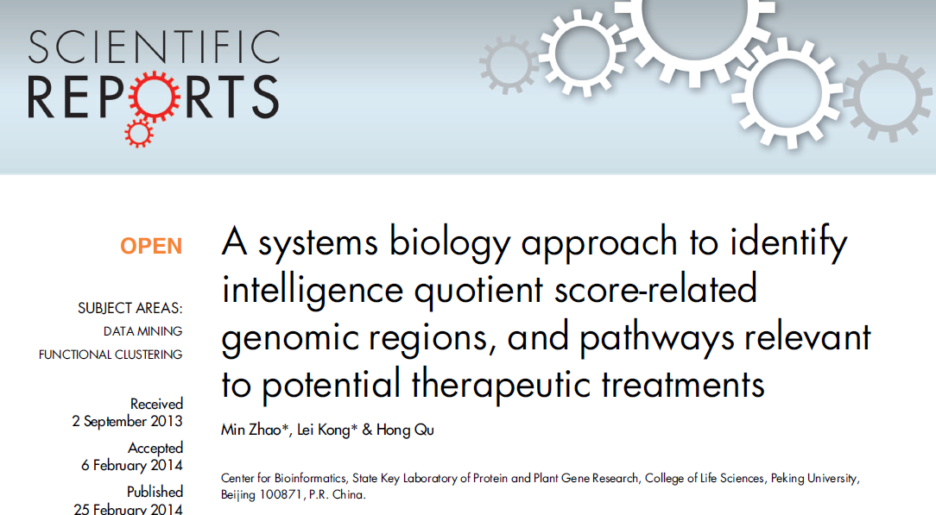

Big Picture (cont’d)

Slide 4
Machine Learning
Learning / extracting patterns from data
Applied when data are analyzed for:
Pattern recognition
Classification and clustering
Prediction
Forming recommendation
Inspired by biology
Unlike modeling methods that conform to the physical laws of the systems being model, machine learning relies on pattern in training data

Slide 5
Supervised vs. Unsupervised Learning *
Supervised Learning / Classification
Training data are labeled, i.e. the output class of all training data are given
Example: predicting if a sequence is an a-helix or a β-sheet
Training set:
Classification:
Unsupervised Learning / Clustering
Training data are not labeled
Output classes must be generated during training
Similarity across features of training examples creates different classes
* Reinforcement learning is not discussed here

Slide 6
Supervised vs Unsupervised Learning (cont’d)
Example (visual insight via scattered plot): Identification of tumor types
Input features: Size of Tumor &
Rate of Growth
Training data create natural clusters
No specific labels are available
Assume all tumors are cancerous
From graph:
Class #1: small size of tumor with small rate of growth
Class #2: small size of tumor with large rate of growth
Class #3: medium size of tumor with medium rate of growth
Class #4: large size of tumor with small rate of growth
Classification: a tumor with SOT=600 & ROG=12% is mapped to Class #3
Classification is performed based on clustering results
Each clustering algorithm results to a classification technique
20 %
10%
Rate of Growth
5%
100
500
1000
Size of Tumor

Slide 7
Clustering
The simplest clustering algorithm: K-means
K-means clustering algorithm
General concept of clustering:
Assume there are K classes
Represent each class with its center
Start with some random initial centers
Find the best centers for classes, i.e.
optimize the centers
In classification phase:
Find the distance of a new pattern from all centers
Find the center whose distance from the the new pattern is minimal
Classify the new pattern to the class whose center has minimal distance from the pattern
Expression Level After Treatment
Expression Level Before Treatment

Slide 8
Clustering (cont’d)
Mathematical formulation:
Randomly initialize the centers m₀, m₁,…, m_{K-1}.
Find the distance of all samples x₀, x₁,…, x_{n-1}
from all centers m₀, m₁,…, m_{K-1}, i.e. for all
0≤i≤n-1 and 0≤j≤K-1 find:
Form classes j = 1,2,…, K-1, by assigning
each sample to the closet center,
i.e. put together all examples whose
distance to center j is minimal to
form class j.
Then find the new centers by finding the sample
that is the closet sample to the average of all
samples in the class, i.e., new m_{j} = average( all examples in class j)

Slide 9
Clustering (cont’d)
Repeat the previous two steps, unless during
the last iteration, no example has changed
its class
Advantages of K-means
Simple and fast
Works on a wide range of simple data
Disadvantages:
Assumes that the number of classes is available
Depends on initial centers
Unable to cluster complicated data
Solutions:
ISODATA
Kohonen self-organizing map

Slide 10
Classification with KNN
Simplest type of classification algorithm: K Nearest Neighbors
General concept:
Calculate the distance of the new example to all known examples (and not just centers)
For each class, find the K known examples that belong to the class and have the minimal distance from the new pattern (among all examples belonging to this class)
Find the total distance of all the examples of each class and do this for all of the classes
The class with minimum total distance wins the new pattern

Slide 11
Classification with KNN (cont’d)
The main advantage of KNN is that, just like neural networks, it does not require the knowledge of probability distribution of the classes
KNN is much less complex and computationally intensive than connectionist methods such as neural networks and support vector machines
More computationally-intensive classifiers exist that do require the exact knowledge or at least an accurate estimation of the distributions

Slide 12
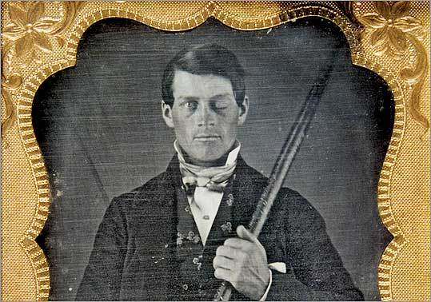
Introduction to Connectionist Models
Why connectionist models?
Algorithms developed over centuries do not fit the complexity of real world problem
The human brain: most sophisticated computer suitable for solving extremely complex problems
Historical knowledge on human brain
Phineas Gage’s Story
In a rail accident, a metal bar was shot
through the head of Mr. Phineas
P. Gage at Cavendish, Vermont,
Sept 14, 1848
Iron bar was 3 feet 7 inches long
and weighed 13 1/2 pounds.
It was 1 1/4 inches in diameter
at one end
http://www.boston.com/news/local/massachusetts/articles/2009/07/22/newly_discovered_image_offers_fresh_insights_about_1848_medical_miracle/ (From the collection of Jack and Beverly Wilgus)

Slide 13
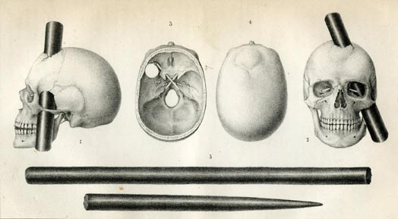
Introduction to Connectionist Models (cont’d)
He survived the accident!
Originally he seemed to have [almost] fully recovered
After a few weeks, Phineas exhibited profound personality changes
This is the first time, researchers have a clear evidence that the brain is not a continuum of cell mass and rather each region has relatively independent task
Bigelow, Henry J. “Dr. Harlow’s case of recovery from the passage of an iron bar through the head.” American Journal of the Medical Sciences, n.s. v.20 (July 1850): 13-22. Available at: https://cms.www.countway.harvard.edu/wp/?tag=phineas-gage

Slide 14
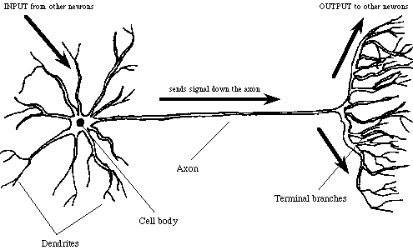
Introduction to Connectionist Models (Continued)
learning and generalization through examples
simple building block: neuron
Dendrites: collecting signals from other neurons
Soma (cell body): spatial summation and processing
Axon: transmitting signals to dendrites of other cells

Slide 15
From biological to artificial neural nets
Reference book: “Fundamentals of Neural Networks; Architecture, Algorithms, And Applications”, by: L. Fausett.
Highly recommended for this course to learn practical applications of neural nets
Biological vs. artificial neurons
From biological neuron to schematic structure of artificial neuron
biological:
Inputs
Summation
of inputs
Processing
unit
Output
artificial:
Activation function
L. Fausett

Slide 16
From biological to artificial neural net (continued)
neuron 1
Artificial neural nets:
Single-layer:
Multi-layer
neuron 2
neuron i
neuron M-1
neuron M

Slide 17
A Supervised NN: Backpropagation Neural Network
Training: using a set of known examples to estimate best values of weights (e.g. backpropagation algorithm)
Architecture:
Number of layers and number of neurons in each layer: variable
It was proved that three layers (one input, one hidden and one output) with sufficient number of neurons in the hidden layer, and learn practically any function
As such there is no need to try more than three layers
A rule of thumb suggests that the number of hidden layers must be less than 1/10 of the number of training examples
Majority of algorithms designed for neural networks are gradient based

Slide 18
Backpropagation Neural Networks (cont’d)
Another issue that all types of machine learning methods, including neural networks can suffer from is overfitting
They can be “over-trained” with the training data and perform poorly on the data they have not seen before
A common approach to address this problem is to ensure that the size of the parameter search space (weight space in case of neural nets) is reduced
For instance, to address this issue neural nets, often a term containing the following value to the cost function to be minimized:

Slide 19
Neural Networks for Clustering
Artificial competitive neural networks:
Each artificial neuron (or group of neurons) stores a pattern
Networks are trained such that neurons in the same neighborhood store similar patterns
During classification, neurons compete to relate to the new pattern
The neurons with highest similarity to the new pattern are the winners
The most popular type of unsupervised neural network is Kohonen Self-Organizing Map (K-map)
K-maps are heavily used in systems biology and bioinformatics, e.g. clustering of gene expression data

Slide 20
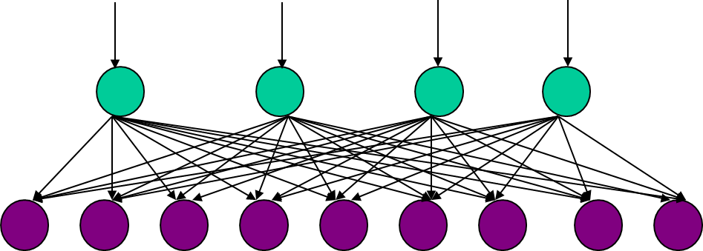
Kohonen Self-Organizing Maps
Kohonen Self-Organizing Map (Kohonen SOM): most popular unsupervised learning machine
Architecture (one-dimensional): (Fausett)
Input neurons map n-dimensional patterns to output (competitive) neurons with p-dimensional output patterns
Output neurons with similar patterns
are arranged to be neighbors
Some output neurons might
store more than one pattern

Slide 21
Kohonen Self-Organizing Maps (continued)
Example: object classification using one-dimensional array
New pattern: hovercraft
is mapped to the nationhood of truck or airplane
Disadvantage: one-dimensional array positions some objects with some similarities far from each other
Inputs
weight (0 to 1)
texture
(wood=0, metal =1)
size (0 to 1)
flies (1) or not (0)
pencil
airplane
chair
book
wooden house
stapler
metal desk
airplane
truck
wooden house
kite
metal desk
chair
stapler
book
pencil
truck
kite

Slide 22
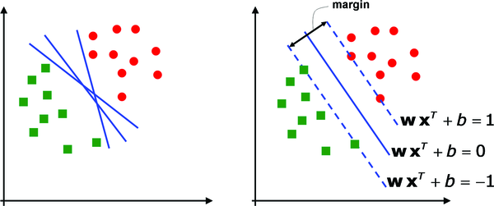
Support Vector Machines (SVMs)
Idea: design classifier such that the margin between boundaries and instances of the classes is optimal (maximum)
Having a good margin makes classifier less susceptible to uncertainty and more likely to learn/generalize the data.
SVM classification boundaries
Different options of classification boundaries
Hyperplanes
Tarca AL, Carey VJ, Chen X-w, Romero R, Drăghici S (2007) Machine Learning and Its Applications to Biology. PLoS Comput Biol 3(6): e116. doi:10.1371/journal.pcbi.0030116

Slide 23
SVMs (cont’d)
Formulation (linear kernel):
Objective: to find w and b such that the hyperplane wx^{T}+b=0 that:
Separates all/most of samples in the two classes
Maximizes the margin between the classes labeled -1 and 1.
Without discussing the details of the solutions to this problem:
This optimization problem can be formulated in at least two different methods and solved rather effectively
Decision function:
The problem can be easily extended into multi-class classification scenarios

Slide 24
SVMs (cont’d)
What if the inputs are not linearly separable in the original feature/input space?
Inputs in the two regions shown here are separable, by
by a good margin, but lines/hyperplanes are not the
best elements to separate them
In such cases, we use a kernel that maps the input
space into space that might create better separation
These kernels are often nonlinear functions with symmetric properties and with [much] higher dimension that the original space
Popular kernels: radial basis functions (RBF) and Gaussian

Slide 25
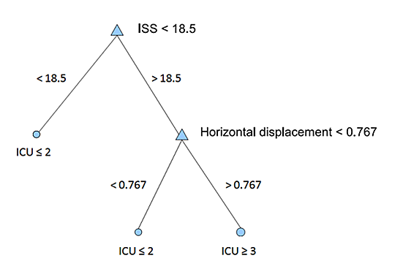
Decision/Regression Trees
Decision and regression trees hierarchically create rules that classify / analyze data
They are very popular in medical applications due to their transparency

Slide 26
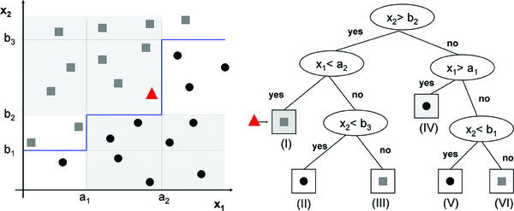
Decision/Regression Trees (cont’d)
A visual example:
Tarca AL, Carey VJ, Chen X-w, Romero R, et al. (2007) Machine Learning and Its Applications to Biology. PLoS Comput Biol 3(6): e116. doi:10.1371/journal.pcbi.0030116
http://www.ploscompbiol.org/article/info:doi/10.1371/journal.pcbi.0030116

Slide 27
Decision/Regression Trees (cont’d)
What measure can tell us:
What variable to branch on next?
What value for this variable is the threshold for branching
Although different measures are used for this purpose, resulting to variety of decision trees, almost all of them are based on entropy, which is a measure of uncertainty/impurity
Entropy quantifies lack of “purity” among the examples left in a given node
High entropy, high impurity
Low entropy, low impurity

Slide 28
Decision/Regression Trees (cont’d)
One typical measure used for splitting nodes; information gain:
Information Gain = Entropy(parent) – [Average Entropy(children)]
Unlike connectionist methods, dealing with categorical variables in the nature of decision trees
There are many tree-based methods such as ID3, CART (Classification and Regression Tree) and C4.5
Decision/regression trees can overfit the data, in particular when depth of the tree becomes too large
Pruning is used to partially address this issue; trees are first expanded to large depth and then pruned/collapsed according to some quality measure

Slide 29
Random Forest
Another solution to address the issue of overfitting when dealing with trees using bootstrapping / bagging
Data are randomly split into subsets
Random subsets of input variables are formed
This allows a level of variable/feature selection not available in many other machine learning models
Using subsets of data and subsets of input variables, trees are forms
Performance of these trees are tested using the data not seen by those trees
This is a level of validation not available in many other tree-based methods

Slide 30
Random Forest (cont’d)
Finally, the output of random forest to a new input will be the average of the output of all trees to that input
Random forest is known to have good accuracy without serious overfitting
Also, it is one of the fastest machine learning methods given its desirable performance
Furthermore, since a level of feature selection is conducted by Random Forest, it may be applied to some datasets large number of input features without feature selection
It was shown, at least in some microarray based studies, that on average Random Forest might produce the best results for bioinformatics applications

Slide 31
Testing and Validation of Machine Learning Models
There are two main approaches:
Training-testing: Randomly divide data into training and testing sets, and test the performance on the testing data.
n-fold cross validation: Randomly divide data into n folds (often n=10) and in a “round-robin” like approach, train the model using n-1 folds and test on the nth. The average the performance over all n trained models.
One approach
Training
Testing
Another approach
Training
Validation / Tune-up
Testing
n=4

Slide 32
Testing and Validation of Machine Learning Models (cont’d)
An extreme but special case of n-fold cross validation is called “leave-one-out” in which for each of the round-robin attempts, all but one example is training and that example is used for testing
If the number of examples is small, leave-one-out is a reasonable option; if not, n-fold cross validation is preferred because it is less likely to overfit the data
Performance measures
Regardless of specific approach used for testing and validation, some popular measures are used for evaluating the goodness of classification
These measures are evaluated based on “confusion matrix”
When diagonal elements are large,
and others are small,
life is beautiful!
Class Positive
Class Negative
Predicted as Positive
True Positive
False Positive
Predicted as Negative
False Negative
True Negative

Slide 33
Testing and Validation of Machine Learning Models (cont’d)
Some important measures based on confusion matrix:

Slide 34
Testing and Validation of Machine Learning Models (cont’d)
For about the same accuracy, machine learning classes can be trained to have a different balance between true sensitivity and specificity; or equivalently the balance between false positive rate (FPR) and true positive rate (TPR)
Remember: FPR=1-Specificity & TPR = Sensitivity
Receiver operating characteristic (ROC) curve is measure to show the trade-off between FPR and TPR
Different threshold values or weighting on
cost functions are used to generate points in ROC
A good ROC is the one that rises early so that high
sensitivity and specificity are achieved at the same time
Area Under Curve (AUC) of ROC
A measure of how fast ROC rises and how soon a good balance point between specificity and sensitivity is achieved
1=
Sensitivity(=TPR)
1-specificity (=FPR)

Slide 35
Feature Reduction / Selection
Fewer features reduces the computational complexity and likelihood of overfitting
There are three main approaches to reduce the number of features:
Using domain knowledge to select some of the most relevant features
Computationally mixing all features to generate fewer combined features (such as PCA)
Computationally selecting a smaller set using a criterion / ranking system
These methods in turn divide into filter-based and wrapper-based methods
Typical measures/criteria used for this process include information gain

Slide 36
Summary
Machine learning applied on molecular / cellular data, along with other types of data, would allow system biologic study of the system
Clustering (unsupervised learning) and classification (supervised learning) are the two main tasks in machine learning
Multilayer perceptron neural networks, support vector machines and regression tress are the main techniques used for classification
Many techniques are based on these methods, e.g. Random Forest is a method based on collective decision of a number of tress

Slide 37
Summary
Machine learning models are susceptible to overfitting issue
Methods such as n-fold cross validation are used for testing and validation of machine learning models
There is often need to reduce dimensionality of data
A number of measures such as sensitivity and specificity are used to assess the quality of a model

